Slide 1

The Internet
Chris Piech
CS106A, Stanford University

Slide 2
I came here to learn to program the internet...

Slide 4
For the third time ever in CS106A:

Slide 5

Learning Goals
Write a program that can make internet requests
Write a program that can respond to internet requests

Slide 6
How does your phone communicate with facebook?

Slide 7
The Java program on your phone talks to the Java program at Facebook

Slide 8
Face Book Server
* Android phones run Java. So do facebook servers

Slide 9
Face Book Server
Is this legit?
piech@cs.stanford.edu
piech@cs.stanford.edu is now logged in

Slide 10
Face Book Server
Send me the full name for
piech@cs.stanford.edu
Chris Piech
“Chris Piech”

Slide 11
Face Book Server
Send me the cover photo for
piech@cs.stanford.edu
Chris Piech

Slide 12
Face Book Server
Send the profile photo for
piech@cs.stanford.edu
Chris Piech

Slide 13
Face Book Server
Send the status for
piech@cs.stanford.edu
Chris Piech
“chillin”
Status: Chris is chillin
Set status:

Slide 14
Face Book Server
Set the status for
piech@cs.stanford.edu
to be “lecturing”
Chris Piech
“success”
Status: Chris is chillin
Set status:
lecturing

Slide 15
Face Book Server
Send me the status for
piech@cs.stanford.edu
Chris Piech
“lecturing”
Status: Chris is chillin
Status: Chris is lecturing
Set status:

Slide 16
Background: The Internet
The internet is just many programs sending messages (as Strings)
Thanks Nick for the teaching YEAH

Slide 17
Background: The Internet
Facebook datacenter
Your computer (facebook.com)
The internet is just many programs sending messages (as Strings)
Thanks Nick for the teaching YEAH

Slide 18
Background: The Internet
Facebook datacenter
Your computer (facebook.com)
“Server”
“Client”
The internet is just many programs sending messages (as Strings)
Thanks Nick for the teaching YEAH

Slide 19
Background: The Internet
Facebook datacenter
Your computer (facebook.com)
Get status for “Julia Daniel”
“Server”
“Client”
The internet is just many programs sending messages (as Strings)
Thanks Nick for the teaching YEAH

Slide 20
Background: The Internet
Facebook datacenter
“response”
Your computer (facebook.com)
“Enjoying lecture”
Get status for “Julia Daniel”
“Server”
“request”
“Client”
The internet is just many programs sending messages (as Strings)
Thanks Nick for the teaching YEAH

Slide 21
There are two types of internet programs. Servers and Clients

Slide 22
Internet 101

Slide 23
Servers are computers (running code)
Face Book Server
=

Slide 24
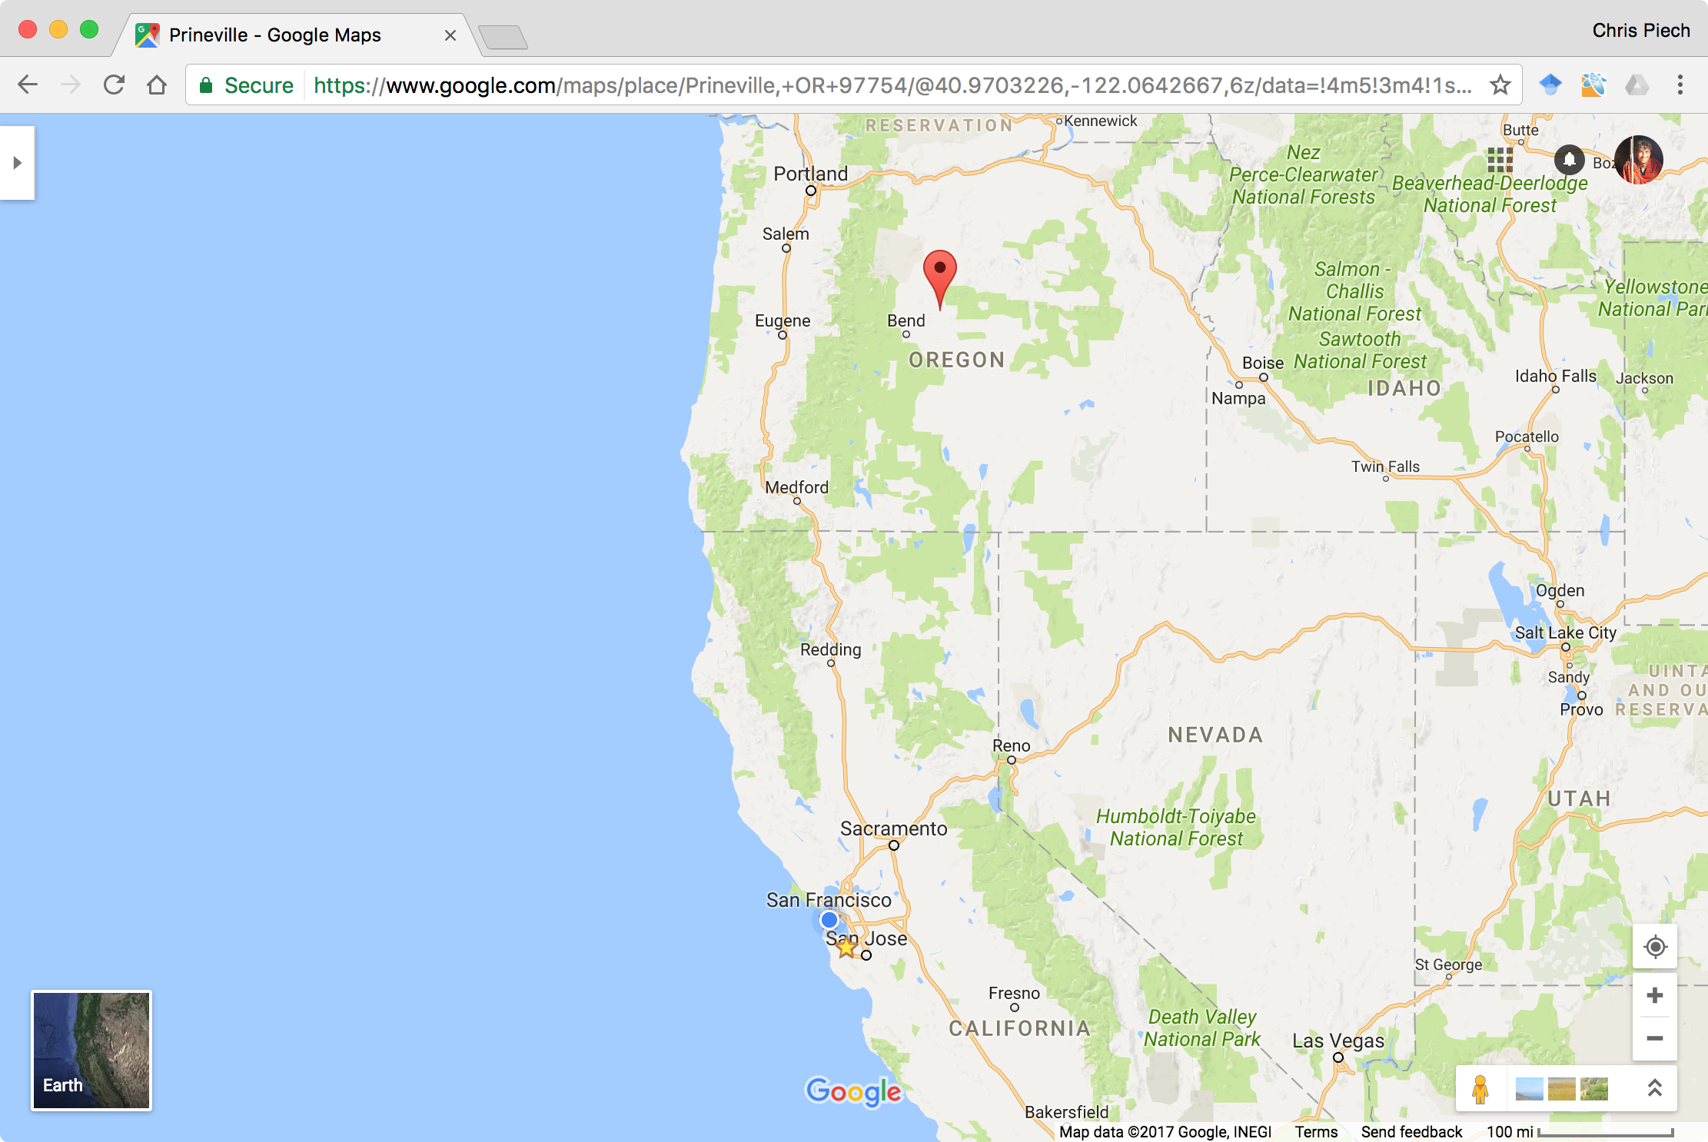
Facebook’s closest datacenter is here
I am here

Slide 25
Face Book Server
The Internet

Slide 26
Face Book Server
The Internet
Get status for piech@cs.stanford.edu

Slide 27
Face Book Server
The Internet

Slide 28
Face Book Server
The Internet

Slide 29
teaching
Face Book Server
The Internet

Slide 30
teaching
Face Book Server
The Internet

Slide 31
Face Book Server
The Internet

Slide 32
Many computers can connect to the same server

Slide 33
The Internet
Facebook datacenter
RESPONSE
REQUEST
REQUEST
Your mom’s computer
(linux shell)
RESPONSE
“Server”
Tate Ole Keko’s computer (facebook.com)
Chris’ phone (facebook app)
“Client”
“Client”
“Client”

Slide 34
Most of the Internet
Aka “the frontend”
Aka “the backend”
Server / Clients
Aka “the cloud”
Aka “the GUI”
Aka “the brains”

Slide 35
There are two types of internet programs. Servers and Clients

Slide 36
First, the server

Slide 37
A Server’s Simple Purpose
Request
someRequest
String
serverResponse
Server

Slide 38
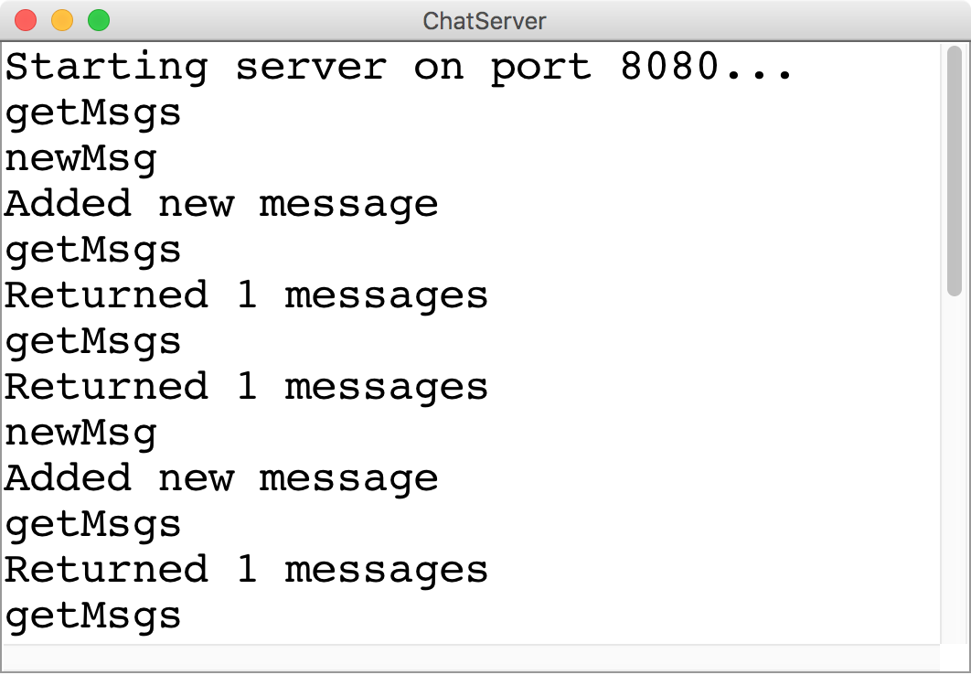
A Server’s Simple Purpose
Request
someRequest
String
serverResponse

Slide 39
Servers on one slide
public String requestMade(Request request) {
// server code goes here
}
1
2
// make a Server object
private SimpleServer server
= new SimpleServer(this, 8000);
3
public void run(){
// start the server
server.start();
}

Slide 40
A Server’s Simple Purpose
public String requestMade(Request request) {
// server code goes here
}
1
2
// make a Server object
private SimpleServer server
= new SimpleServer(this, 8000);
3
public void run(){
// start the server
server.start();
}

Slide 41
What is a Request?
/* Request has a command */
String command;
/* Request has parameters */
HashMap<String,String> params;
Request request
// methods that the server calls on requests
request.getCommand();
request.getParam(key); //returns associated value

Slide 42
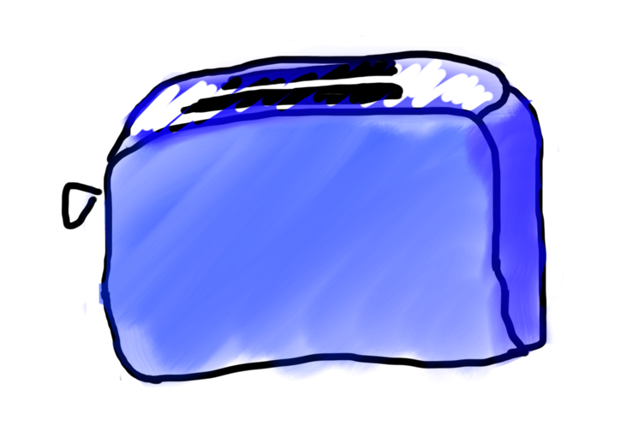
Requests are like Remote Method Calls
Server has a bunch of discrete things it can do
Server
makeToast
blendIngedients

Slide 43
Requests are like Remote Method Calls
Server has a bunch of discrete things it can do
Server
getStatus
addUser

Slide 44
Requests are like Remote Method Calls
Server
getStatus
addUser

Slide 45
Requests are like Remote Method Calls
request.getCommand();
=> ”getStatus”
Server
getStatus
addUser

Slide 46

Requests are like Remote Method Calls
To make toast, I need a parameter which is the kind of bread
getStatus

Slide 47
Requests are like Remote Method Calls
I was given a parameter!
getStatus

Slide 48
Requests are like Remote Method Calls
request.getParam(“userName”)
getStatus

Slide 49

Requests are like Remote Method Calls
getStatus

Slide 50

Requests are like Remote Method Calls
cpiech
getStatus

Slide 51


Requests are like Remote Method Calls
teaching

Slide 52

public String requestMade(Request request) {
String cmd = request.getCommand();
if(cmd.equals(“getStatus”)) {
String user = request.getParam(“userName”);
String status = runGetStatus(user);
}
...
}
return status;
.toString()???

Slide 53

Requests are like Remote Method Calls

Slide 54
Requests are like Remote Method Calls

Slide 55
Requests are like Remote Method Calls

Slide 56
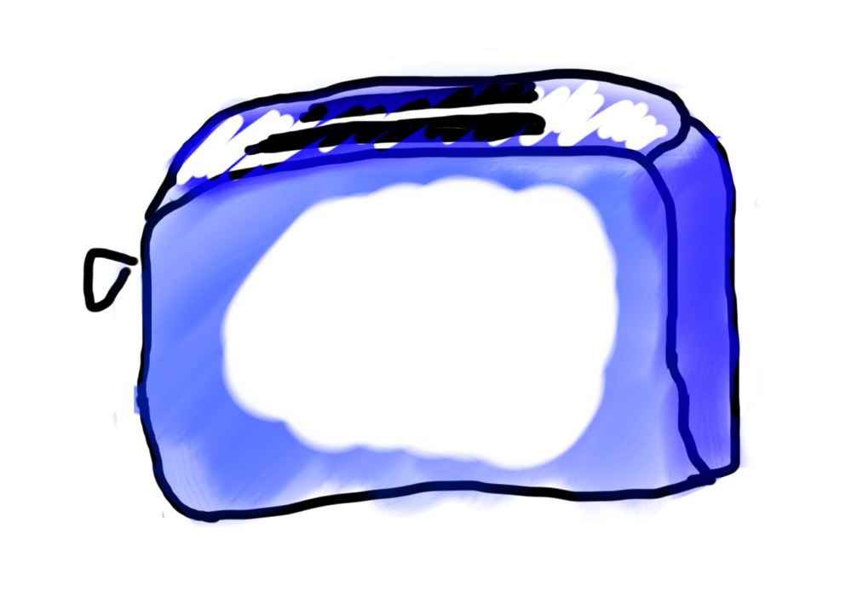
Requests are like Remote Method Calls

Slide 57

Requests are like Remote Method Calls

Slide 58
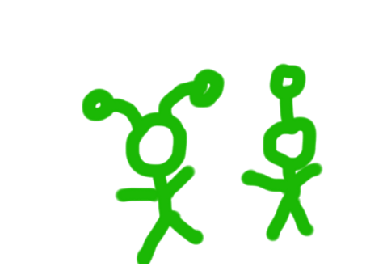
Requests are like Remote Method Calls

Slide 59
What is a Request?
/* Request has a command */
String command;
/* Request has parameters */
HashMap<String,String> params;
Request request
// methods that the server calls on requests
request.getCommand();
request.getParam(key); //returns associated value

Slide 60
A Server’s Simple Purpose
public String requestMade(Request request) {
// server code goes here
}
1
2
// make a Server object
private SimpleServer server
= new SimpleServer(this, 8000);
3
public void run(){
// start the server
server.start();
}

Slide 61
A Server’s Simple Purpose
public String requestMade(Request request) {
// server code goes here
}
1
2
// make a Server object
private SimpleServer server
= new SimpleServer(this, 8000);
3
public void run(){
// start the server
server.start();
}

Slide 62
What is a Port?

Slide 63
Servers on one slide
public String requestMade(Request request) {
// server code goes here
}
1
2
// make a Server object
private SimpleServer server
= new SimpleServer(this, 8000);
3
public void run(){
// start the server
server.start();
}

Slide 64
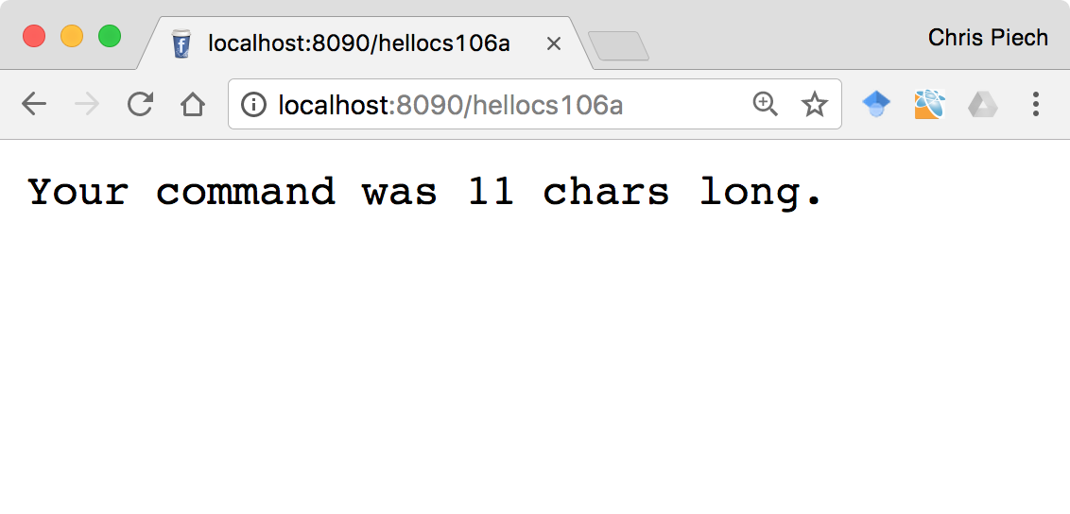
Echo Server

Slide 65
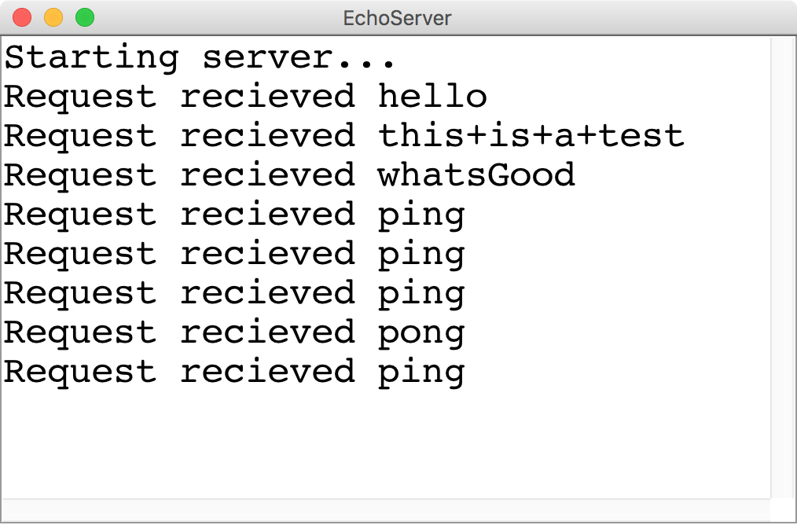
Echo Server
Request
Any Request
String
Length of the cmd

Slide 66
There are two types of internet programs. Servers and Clients

Slide 67
Then, the client

Slide 68
A Clients’s Purpose
1. Interact with the user
2. Get data from its server
3. Save data to its server

Slide 69
Clients on one slide
try {
// 1. construct a new request
Request example = new Request("getStatus");
// 2. add parameters to the request
example.addParam("name", "chris");
// 3. send the request to a computer on the internet
String result = SimpleClient.makeRequest(HOST, example);
} catch(IOException e) {
// The internet is a fast and wild world my friend
}

Slide 70
Clients on one slide
try {
// 1. construct a new request
Request example = new Request("getStatus");
// 2. add parameters to the request
example.addParam("name", "chris");
// 3. send the request to a computer on the internet
String result = SimpleClient.makeRequest(HOST, example);
} catch(IOException e) {
// The internet is a fast and wild world my friend
}

Slide 71
Clients on one slide
try {
// 1. construct a new request
Request example = new Request("getStatus");
// 2. add parameters to the request
example.addParam("name", "chris");
// 3. send the request to a computer on the internet
String result = SimpleClient.makeRequest(HOST, example);
} catch(IOException e) {
// The internet is a fast and wild world my friend
}

Slide 72
Clients on one slide
try {
// 1. construct a new request
Request example = new Request("getStatus");
// 2. add parameters to the request
example.addParam("name", "chris");
// 3. send the request to a computer on the internet
String result = SimpleClient.makeRequest(HOST, example);
} catch(IOException e) {
// The internet is a fast and wild world my friend
}

Slide 73
Clients on one slide
try {
// 1. construct a new request
Request example = new Request("getStatus");
// 2. add parameters to the request
example.addParam("name", "chris");
// 3. send the request to a computer on the internet
String result = SimpleClient.makeRequest(HOST, example);
} catch(IOException e) {
// The internet is a fast and wild world my friend
}

Slide 74
Clients on one slide
try {
// 1. construct a new request
Request example = new Request("getStatus");
// 2. add parameters to the request
example.addParam("name", "chris");
// 3. send the request to a computer on the internet
String result = SimpleClient.makeRequest(HOST, example);
} catch(IOException e) {
// The internet is a fast and wild world my friend
}

Slide 75
Clients on one slide
try {
// 1. construct a new request
Request example = new Request("getStatus");
// 2. add parameters to the request
example.addParam("name", "chris");
// 3. send the request to a computer on the internet
String result = SimpleClient.makeRequest(HOST, example);
} catch(IOException e) {
// The internet is a fast and wild world my friend
}

Slide 76
Clients on one slide
try {
// 1. construct a new request
Request example = new Request("getStatus");
// 2. add parameters to the request
example.addParam("name", "chris");
// 3. send the request to a computer on the internet
String result = SimpleClient.makeRequest(HOST, example);
} catch(IOException e) {
// The internet is a fast and wild world my friend
}

Slide 77
Time for a little chat

Slide 78
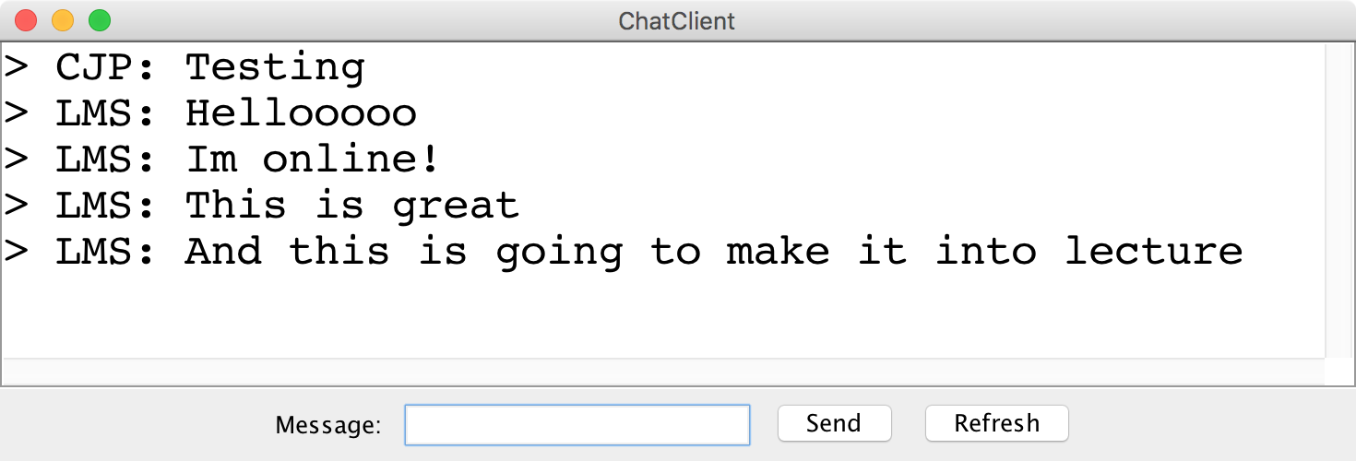
Chat Server and Client

Slide 79
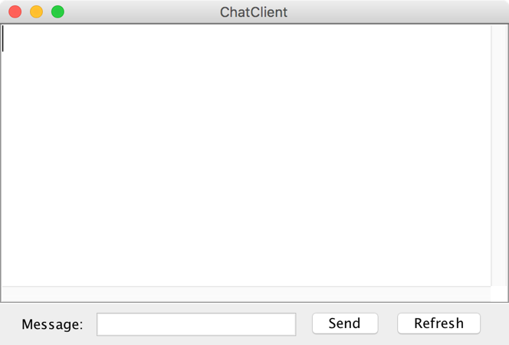
history = [
]
addMsg
msg = C: Hello world
Chat Client
Chat Client
Send
Hello world
Send

Slide 80
history = [
C: Hello world
]
getMsgs
index = 0
Chat Client
Chat Client
Send
Send

Slide 81
history = [
C: Hello world
]
[C: Hello world]
Chat Client
Chat Client
> C: Hello world
> C: Hello world
Send
Send

Slide 82
history = [
C: Hello world
]
addMsg
msg = B: Im here too
Chat Client
Chat Client
> C: Hello world
> C: Hello world
Im here too
Send
Send

Slide 83
history = [
C: Hello world,
B: Im here too
]
getMsgs
index = 1
Chat Client
Chat Client
> C: Hello world
> C: Hello world
Send
Send

Slide 84
history = [
C: Hello world,
B: Im here too
]
[B: Im here too]
Chat Client
Chat Client
> C: Hello world
> C: Hello world
> B: Im here too
> B: Im here too
Send
Send

Slide 85
Chat Server
addMsg
msg = text
Chat Server
getMsgs
index = startIndex

